Slide 1
Iris Health Dashboard
William Gu

Slide 2
Who am I ?
Georgia Institute of Technology
Major: Computer Science & EE
Status: Senior
Threads: Info Networks & AI

Slide 3
PayPal And Me
Team: ToolsTeam(CPI)
Manager: Dennis Brazil

Slide 4
What is Iris ?
The iris Console is an Alerting Console that receives events from many event sources throughout PayPal operations.
Iris routes/distributes alerts to separate views for each respective teams to act on.

Slide 5
Iris Architecture
Query & de-dupe or create alert
SQL queries
Poll alerts via REST API
Forward event
Database (MySQL)
Poll alerts via REST API
Iris UI/API Server
Iris Central Server
Iris Proxy
Other REST API Clients
Event Producer

Slide 6
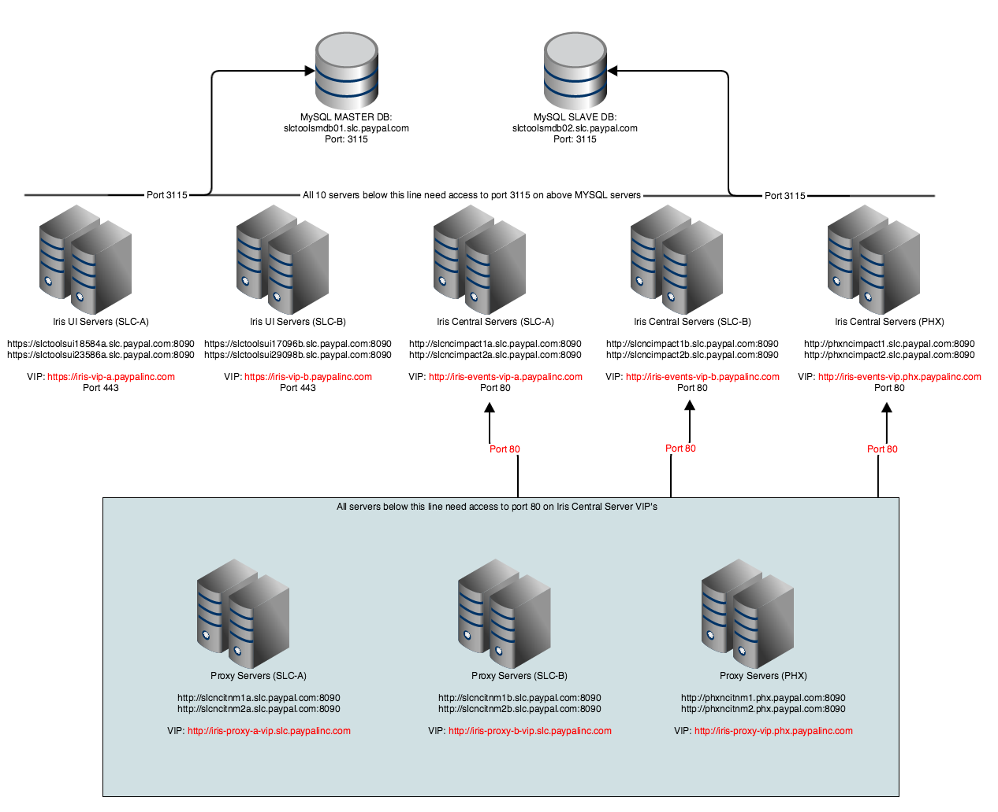
Iris Architecture
UI Servers
Central Servers
Proxy Servsers

Slide 7
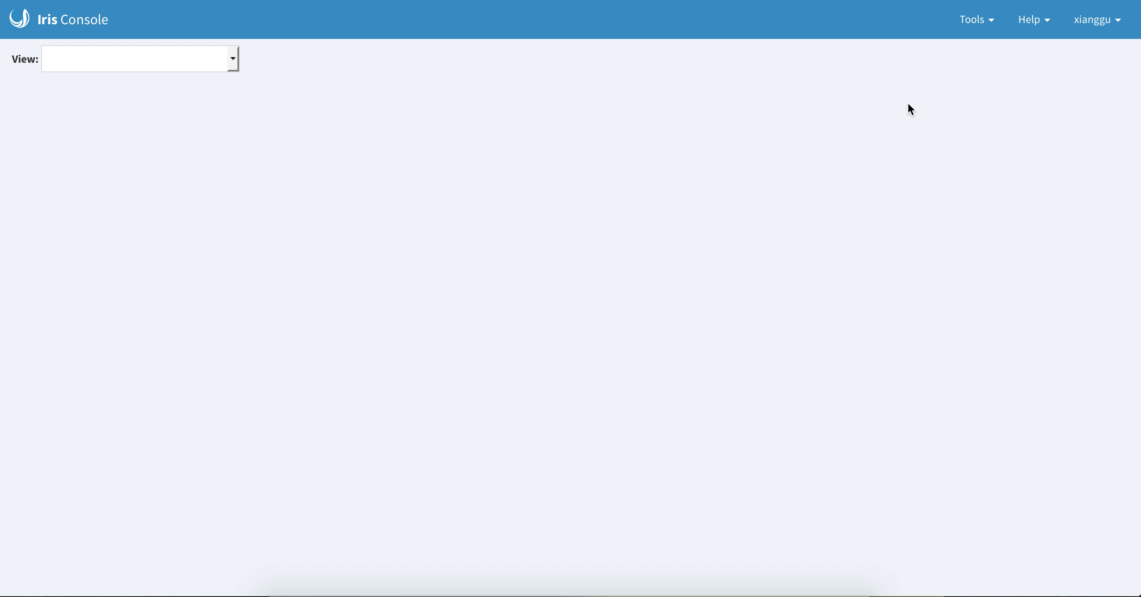
My Project: Iris Health Dashboard

Slide 8
Usage
Easily detect bad Iris servers
Keep track of the most updated server status
Find out the reasons of server failure
Efficient Iris monitoring

Slide 9

Iris & Future

Slide 10
Thank You !

Slide 11


